Slide 1
Digital Image Processing
Chapter 2:
Image Representation

Slide 2
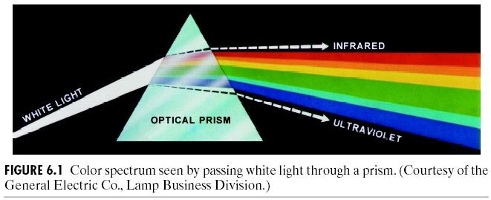
Spectrum of White Light
1666 Sir Isaac Newton, 24 year old, discovered white light spectrum.
(Images from Rafael C. Gonzalez and Richard E. Wood, Digital Image Processing, 2nd Edition.

Slide 3
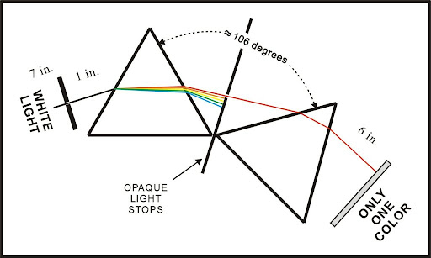
Is Other Color Pure?

Slide 4
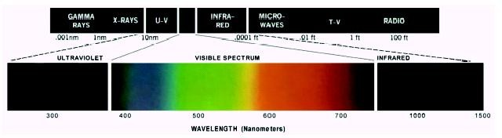
Electromagnetic Spectrum
Visible light wavelength: from around 400 to 700 nm
For an achromatic (monochrome) light source,
there is only 1 attribute to describe the quality: intensity
For a chromatic light source, there are 3 attributes to describe the quality:
Radiance = total amount of energy flow from a light source (Watts) Luminance = amount of energy received by an observer (lumens) Brightness = intensity
(Images from Rafael C. Gonzalez and Richard E. Wood, Digital Image Processing, 2nd Edition.

Slide 5

Color of Light
Perceived color depends on spectral content (wavelength composition)
– e.g., 700nm ~ red.
“spectral color”
A light with very narrow bandwidth
UMCP ENEE408G Slides (created by M.Wu & R.Liu © 2002)
“Spectrum” from http://www.physics.sfasu.edu/astro/color.html
A light with equal energy in all visible bands appears white

Slide 6
Primary and Secondary Colors
Primary color
Secondary colors
Primary color
Primary color

Slide 7
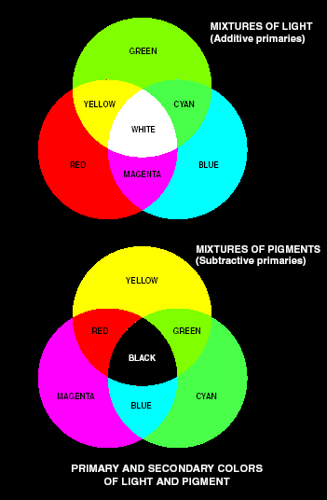
Primary and Secondary Colors (cont.)
Additive primary colors: RGB use in the case of light sources such as color monitors
RGB add together to get white
Subtractive primary colors: CMY use in the case of pigments in printing devices
White subtracted by CMY to get Black
(Images from Rafael C. Gonzalez and Richard E. Wood, Digital Image Processing, 2nd Edition.

Slide 8
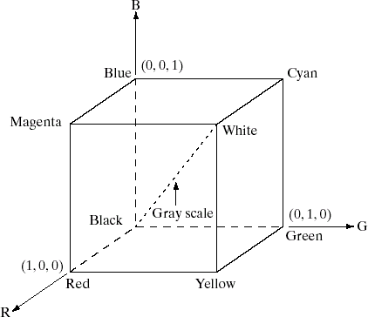
RGB Color Model
Purpose of color models: to facilitate the specification of colors in some standard
RGB color models:
- based on cartesian coordinate system
(Images from Rafael C. Gonzalez and Richard E. Wood, Digital Image Processing, 2nd Edition.

Slide 9
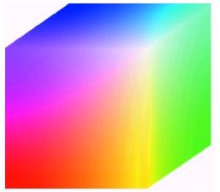
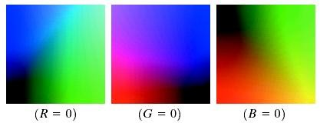
RGB Color Cube
R = 8 bits G = 8 bits B = 8 bits
Color depth 24 bits
= 16777216 colors
Hidden faces of the cube
(Images from Rafael C. Gonzalez and Richard E. Wood, Digital Image Processing, 2nd Edition.

Slide 10
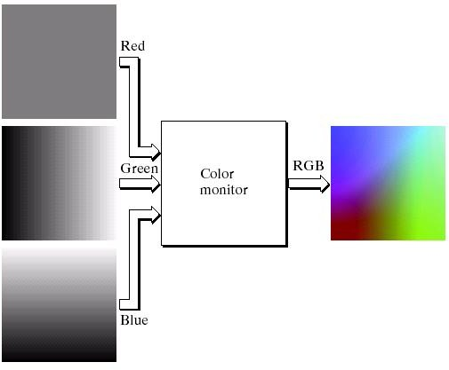
RGB Color Model (cont.)
Red fixed at 127
(Images from Rafael C. Gonzalez and Richard E. Wood, Digital Image Processing, 2nd Edition.

Slide 11
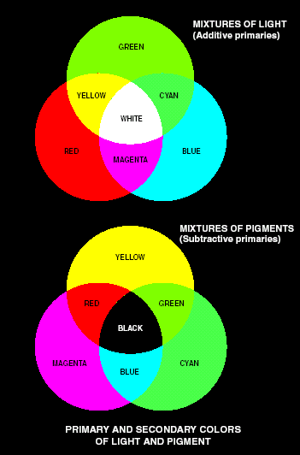
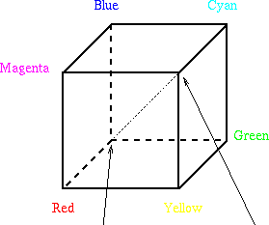
CMY and CMYK Color Models
C = Cyan
Primary colors for pigment
Defined as one that subtracts/absorbs a primary color of light & reflects the other two
CMY – Cyan, Magenta, Yellow
Complementary to RGB
Proper mix of them produces black
M = Magenta Y = Yellow K = Black
⎡C ⎤ ⎡1⎤ ⎡R⎤
⎢_{M} ⎥₌⎢₁⎥₋ ⎢_{G}⎥
⎢ ⎥ ⎢⎥ ⎢ ⎥
⎢⎣Y ⎥⎦ ⎢⎣1⎥⎦ ⎢⎣B⎥⎦

Slide 12
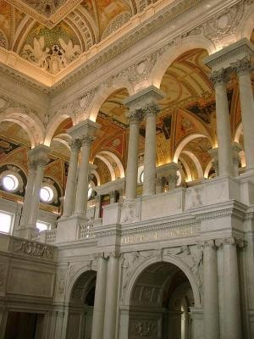
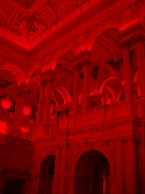
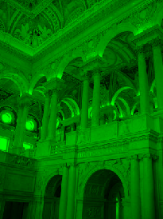
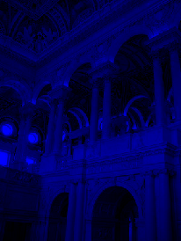
Examples
RGB

Slide 13
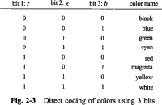
Direct Coding
Image representation is essentially the representation of pixel colors.
Using direct coding we allocate a certain amount of storage space for each pixel to code its color.
For example, we may allocate 3 bits for each pixel, with one bit for each primary color.
This 3-bit representation allows each primary to vary
independently between two intensity levels:
0 (off) or 1 (on).
Hence each pixel can take on one of the eight colors that correspond to the corners of the RGB color cube.

Slide 14
Direct Coding
A widely accepted industry standard uses 3 bytes, or 24 bits, per pixel, with one byte for each primary color.
This way we allow each primary color to have 256 different intensity levels,
corresponding to binary values from 00000000 to 11111111.
Thus a pixel can take on a color from 256 x 256 x 256 or
16.7 million possible choices.
The 24-bit format is commonly referred to as the true color representation, for the difference between two colors that differ by one intensity level in one or more of the primaries is virtually undetectable under normal viewing conditions.

Slide 15
Direct Coding
A notable special case of direct coding is the representation of
black-and-white (bilevel) and
gray-scale images, where the three primaries have the same value and
hence need not be coded separately.
A black-and-white image requires only one bit per pixel, with bit value 0 representing black and 1 representing white.
A gray-scale image is typically coded with 8 bits per pixel to allow a total 256
intensity or gray levels.
Although this direct coding method features simplicity and has supported a variety of applications, we can see a relatively high demand for storage space when it comes to the 24-bit standard.
For example, a 1000 x 1000 true color image would take up three million
bytes.
Furthermore, even if every pixel in that image had a different color, there would only be one million colors in the image.
In many applications the number of colors that appear in any one particular
image is much less.
Therefore the 24-bit representation’s ability to have 16.7 million different colors appear simultaneously in a single image seems to be somewhat overkill.

Slide 16
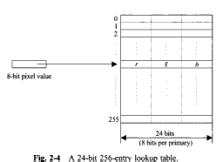
Lookup Table
Image representation using a lookup table can be viewed as a compromise between our desire to have a lower storage requirement and our need to support a reasonably sufficient number of simultaneous colors.
In this approach pixel values do not code colors directly.
Instead, they are addresses or indices into a table of color values.
The color of a particular pixel is determined by the color value in
the table entry that the value of the pixel references.
Figure shows a lookup table with 256 entries.
The entries have addresses 0 through 255.
Each entry contains a 24-bit RGB color value.
Pixel values are now 1-byte, or 8-bit, quantities.

Slide 17
Lookup Table
The color of a pixel whose value is i, where 0<=i<=255, is determined by
the color value in the table entry whose address is i.
This 24-bit 256-entry look up table representation is often
referred to as the 8-bit format.
It reduces the storage requirement of a 1000 x 1000 image to one million bytes plus 768 bytes for the color values in the lookup table.
It allows 256 simultaneous colors that are chosen from 16.7 million possible colors.
It is important to remember that,
using the lookup table representation,
an image is defined not only by its pixel values but also
by the color values in the corresponding lookup table.
Those color values form a color map for the image.

Slide 18
Summary
UMCP ENEE631 Slides (created by M.Wu © 2004)
Monochrome human vision
visual properties: luminance vs. brightness, etc.
Color
Color representations and three primary colors
Color coordinates
Color Model
Direct Coding
Lookup Table

Slide 19
Questions of the day
- How will a printer print white color if it uses CMYK model?
- How will the lookup table be generated means how will it select which colors to be chosen to be indexed?

